Slide 1
Using Concur Expense Reporting Tool RAS Reimbursement Information and Procedure
March 2020

Slide 2
Table of Contents
Requirements & Getting Started
Expense Report Process Flow
Western Union & Concur Supported Currencies
Tips & Tricks
Common Expense Report Mistakes
Advantages of Using Concur
Questions
Appendix

Slide 3
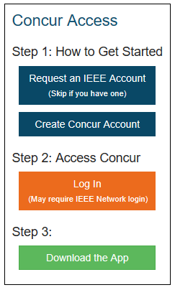
Requirements & Getting Started
Concur Home Page on ieee.org (no username/password required)
Concur Volunteer Expense Reimbursement Platform (to open right click then select open hyperlink)
Requirements
IEEE Account
Skip this step if you already have an account
Create Concur Account
Account creation/activation takes approximately 24-36 hours
Email notification upon account activation with log in instructions (Appendix A)
Western Union enrollment notification will be emailed if necessary (Appendix B)
Default reimbursement currency is based on your Country of Residence
Getting Started
Log into Concur by clicking on the orange Log In button (only way to access Concur). Please use your IEEE User name and password. No additional passwords required.
A mobile app is also available for use, please click on the green button for more details

Slide 4
Submitting a Cover Letter
Reports submitted through Concur should be submitted with a Cover Letter.
Prepare a cover letter, briefly explaining: (i) nature of the expense; (ii) authorization and approval of the expense, (iii) why you should be receiving the reimbursement, and (iiii) for how much. e.g., approved by RAS President or based on an AdCom approved motion. Attach a copy of the email approval or similar document. For AdCom and ExCom members traveling to AdCom meetings, such an approval is not needed and your reimbursable amount is limited by the current travel policy.
Save the cover letter as a pdf then attach it by opening the expense report in Concur then clicking Receipts > Attach Receipt Images (See image below). This action will add the pre-approval to the entire expense report (it will not save the attachment to a single line item like most receipts).

Slide 5
Expense Report Process Flow
Creating an Expense Report
Submitter will select 4 tiered Expense Report Purpose (ERP) Levels (Appendix C)
The ERP selections drive:
GL coding - Entity, Business Unit, Cost Center, CB Account number/HOP number
Approval Flow
The ERP can be changed at the line item level for splitting/allocating expenses
Approval Flow of Expense Report
Approver(s) – RAS Staff and RAS Treasurer
Best Practice is to have 2 Approvers per expense report purpose
Standard IEEE review and processing typically takes 3-5 business days
Report is Ready for Payment
Payment is made electronically directly to your bank account (paper checks have been discontinued)

Slide 6
Western Union & Concur Supported Currencies
Concur or Western Union?
The reimbursement currency in your Concur profile is based on your Country of Residence. If you reside in a Country where the local currency is USD, EUR, CAD, or INR you must enter your banking information directly into Concur.
All other currencies require the user to enroll in Western Union, this is a one time enrollment
Payment cannot be completed until banking information is provided
Security of Banking Information
Personal information entered in the profile is secure and can only be managed by the user
Concur meets ISO, SSAE, and PCI Compliance standards, ensuring the utmost in security measures

Slide 7
Tips & Tricks
Concur Mobile App
Allows you to create, submit, and/or approve expense reports directly from your phone or tablet
Take a photo of your receipts with the mobile app and Concur’s OCR Technology will help auto-populate expense lines
Receipt Options
Email receipts to: receipts@concur.com they will automatically upload into your Concur profile
Integration with 3rd party applications (e.g., Uber, Lyft, etc.) result in electronic receipt creation
A missing receipt affidavit can be applied if a receipt is lost/damaged (Appendix D)

Slide 8
Common Expense Report Mistakes
Transactions in excess of USD 25 require a receipt
Credit Card Statements are not a valid substitute for receipts
When entering expenses in Concur, you must use the currency in which the transaction was incurred
Expenses must be recorded on the date the transaction occurred
Receipt date = Transaction date
Concur Account Access (Appendix E)
You must log into Concur via the link on ieee.org and select the orange log in button
Username & Password are not required due to integration with IEEE Single Sign On Network

Slide 9
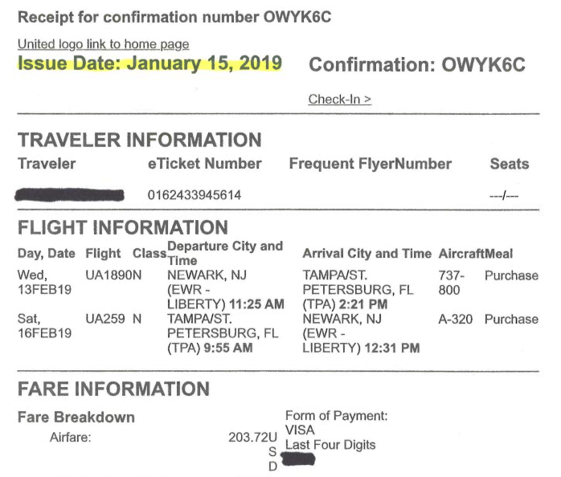
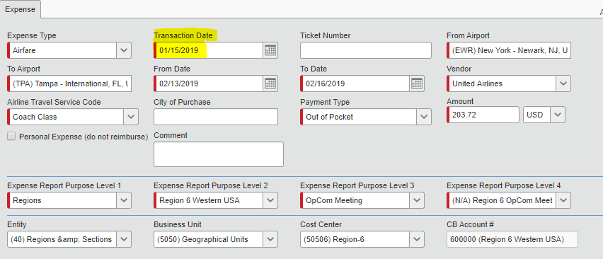
Verify Receipt Date = Transaction Date

Slide 10
Advantages of Using Concur
Audit Trail & Approval Flow
Real-time audit/status tracking visible to the submitter
To view the approval flow for your expense report
Details > Approval Flow > Click on the Bolded ERP to expose the approval flow (Appendix F)
Please note: you can only see the approval flow after the report has been submitted
Currency Conversions (Appendix G)
Concur automatically converts foreign currency transactions on the users behalf
If the currency conversion calculated by Concur differs from the conversion charged on your credit card, you can submit a separate expense line for Currency Exchange Fees to make your reimbursement whole
Delegate Responsibility (Appendix H)
Users can designate a delegate to submit/approve expense reports on their behalf
A missing receipt affidavit cannot be submitted by a delegate
A delegate cannot change profile information i.e. bank info, address, etc.

Slide 11
Questions
Please send all questions, comments, feedback and suggestions to: concurfeedback@ieee.org

Slide 12
Appendix
Concur Sample Enrollment Email – reimbursement in USD, CAD, EUR, INR
Western Union Sample Enrollment Email – all currencies except USD, CAD, EUR, INR
Tiered Expense Report Purpose (ERP) Levels
Missing Receipt Affidavit
Concur Account Log In
Approval Flow
Expense Types
Delegates
EURO Countries Supported by Concur’s Payment Mechanism

Slide 13
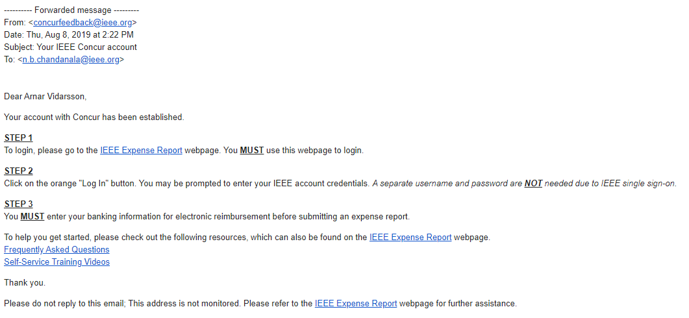
Concur Sample Enrollment Email (reimbursement in USD, CAD, EUR, INR)
Appendix A

Slide 14
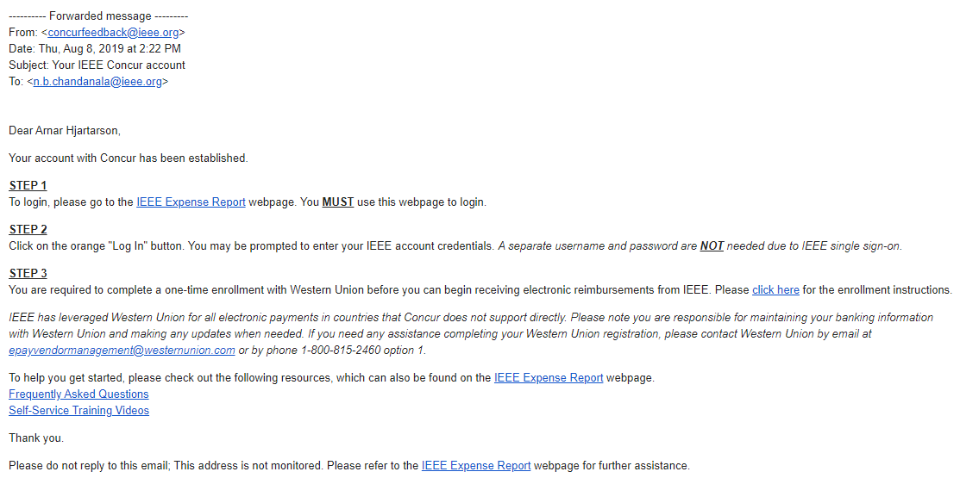
Western Union Sample Enrollment Email (all currencies except USD, CAD, EUR, INR)
Appendix B

Slide 15
Tiered Expense Report Purpose (ERP) Levels 1 and 2
Appendix C
For RAS travel, selections for Level 1 and 2 are always as follows:
Expense Report Purpose Level 1 - Technical Activities Societies
Expense Report Purpose Level 2 - Robotics & Automation

Slide 16
Tiered Expense Report Purpose (ERP) Levels 3 and 4
Appendix C
For RAS travel, selections for Level 3 and 4 are as follows:
LEVEL 4 | LEVEL 4
AdCom Travel | ADCMX
Chapter Chair Travel | CHPTR
Conf Committee Travel (Conference Committee Travel) | XCNFX
Conf Committee Travel Other | 00000
Distinguished Lecturer Travel | DISLR
ExCom Travel | EXCOM
Industrial Activities Travel | XIABX
Initiative Travel (New initiatives and projects) | XINIT
Member Activities Travel | MEMCO
New Initiative Travel Membership | 00000
New Initiative Travel Outreach | OUTRC
President Travel | XPRES
Publication Activities Travel | PUBCO
RA Magazine: Editor Travel | 00000
RA-Letters: Editor Travel | PUBCO
SIGHT Travel | SIGHT
Standards Travel | XSTDX
Technical Activities Travel | TECHN
Trans-ASE: Editor Travel | 00000
Treasurer Travel | TREAS

Slide 17
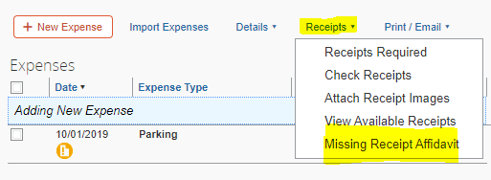
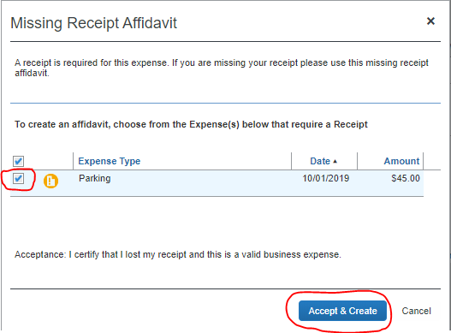
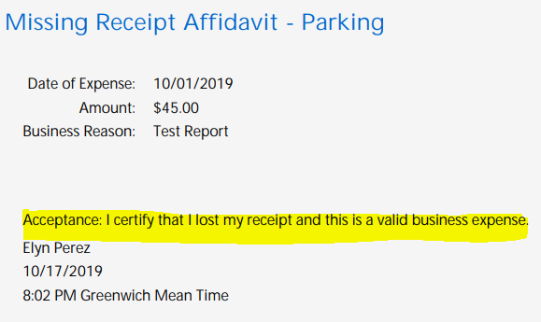
Missing Receipt Affidavit
Appendix D
Step 1 - How to Navigate
Step 2 - Select Transaction
Step 3 - Final Confirmation

Slide 18
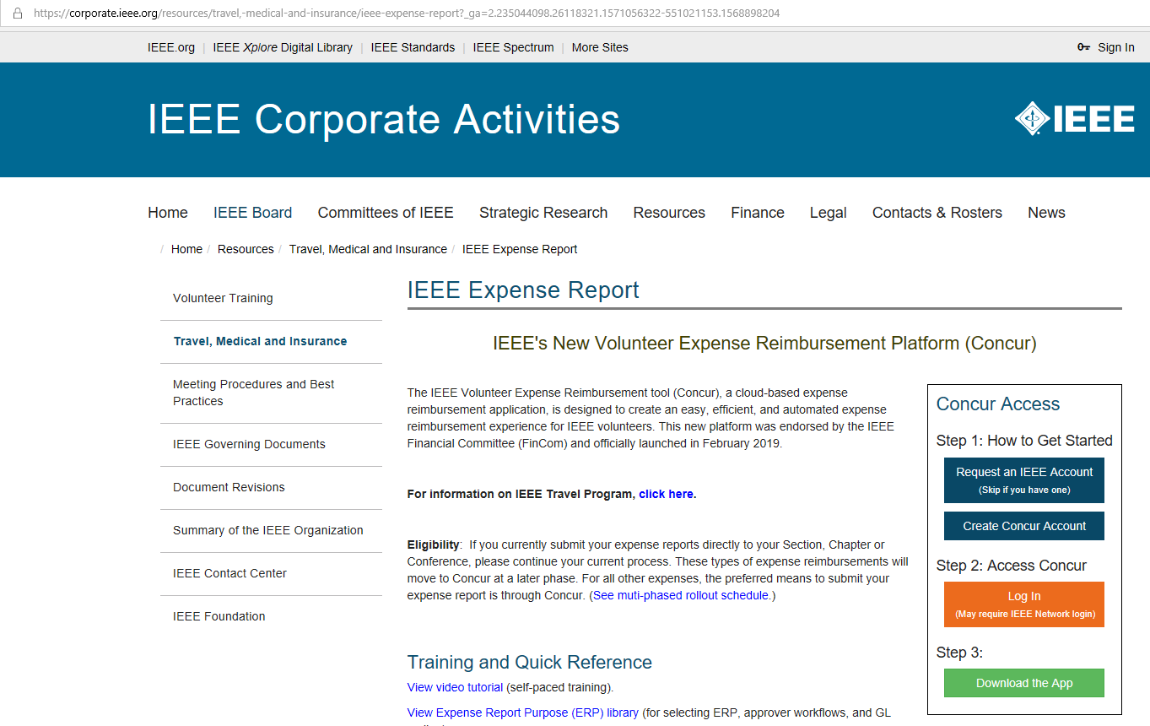
Concur Account Log In
Appendix E
Concur Home Page on ieee.org (no username/password required)

Slide 19
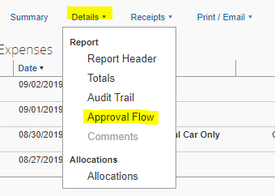
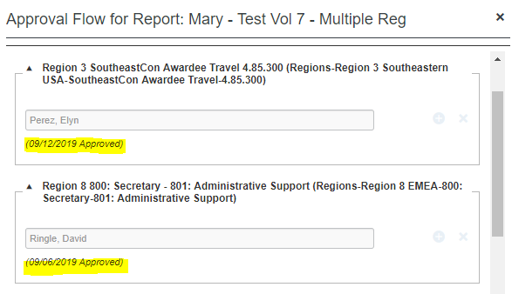
Approval Flow
Appendix F
Step 1 - How to Navigate
Step 2 – Approval Flow expanded showing an Expense Report with Multiple Region ERP’s
*Please note: You can only see the approval flow after the report has been submitted*

Slide 20
Expense Types
Appendix G

Slide 21
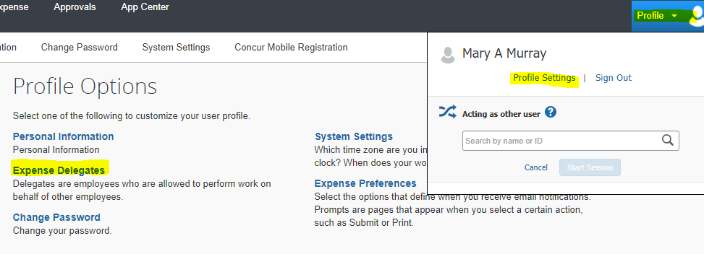
Delegates
Appendix H
Step 1 - How to Navigate
Profile > Profile Settings > Expense Delegates
Step 2 – How to Add Delegate
Click Add > Type in Users Name > Select the Desired Check Boxes > Save

Slide 22
Euro Countries Supported by Concur’s Payment Mechanism
Appendix I
Austria | Ireland
Belgium | Italy
Finland | Luxembourg
France | Netherlands
Germany | Portugal
Greece | Spain
in addition to USD, CAD, INR
(otherwise payment completed via Western Union)

