Slide 1
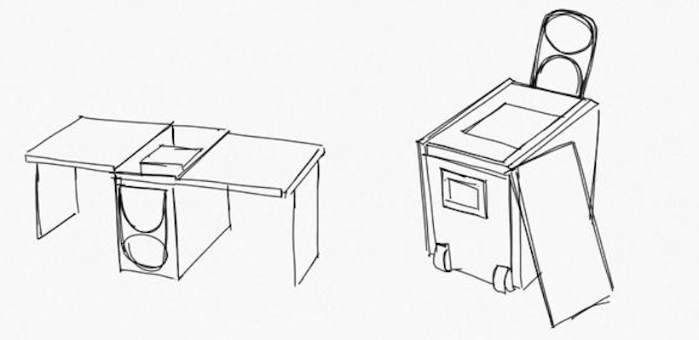
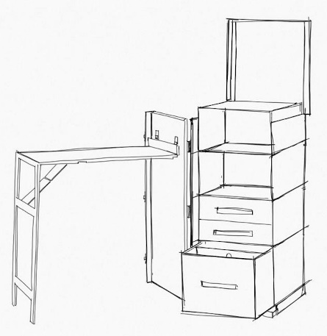
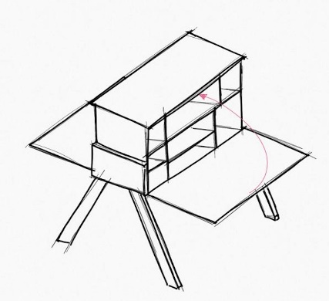
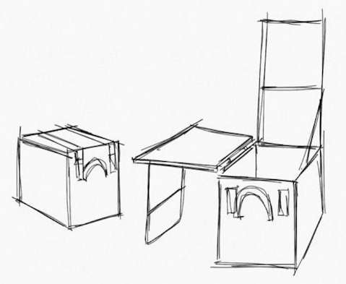
Humanitarian Innovation: Portable Lab, Training, Workshop and Hackathon
Imad H. Elhajj, Ghena Hammour, Aline Germani, Daniel Asmar, Hala Ghattas, Zaher Dawy Humanitarian Engineering Initiative | American University of Beirut
Motivation
With the rapid advancement of technology and extensive use of robotics and automation, underprivileged students in public schools still lack the accessibility to robotics and automation education.
Solution
We aim to make basics of robotics and automation education accessible and affordable to all students, and to equip them with technological tools triggering their curiosity to someday solve their own problems based on their needs.
Project
We are developing and building the Humanitarian Innovation portable lab that will provide the flexibility and convenience of performing workshops, trainings, and Hackthons at schools that lack resources and infrastructure.
Deliverables
Humanitarian Innovation Portable Lab
Teachers and students training workshops
Teacher-Student Hackathon

